Slide 1
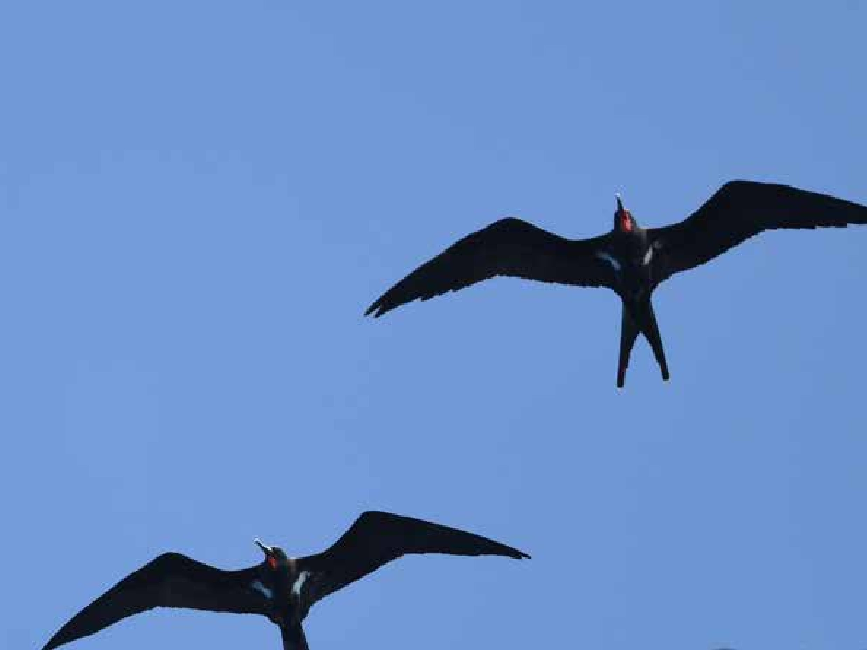
Palau Seabird Survey & Monitoring Workshop
Koror, 26-30 October 2026
Ray Pierce, Eco Oceania
Monica Gruber, Pacific Biosecurity
Etienne Delattre, SPREP
Notes:
Cover slide image: Lesser Frigatebirds, Kiribati. Hiroyuki Tanoi

Slide 2
Day 3: Review and evaluation
Ray Pierce and Monica Gruber
Notes:
Monica

Slide 3
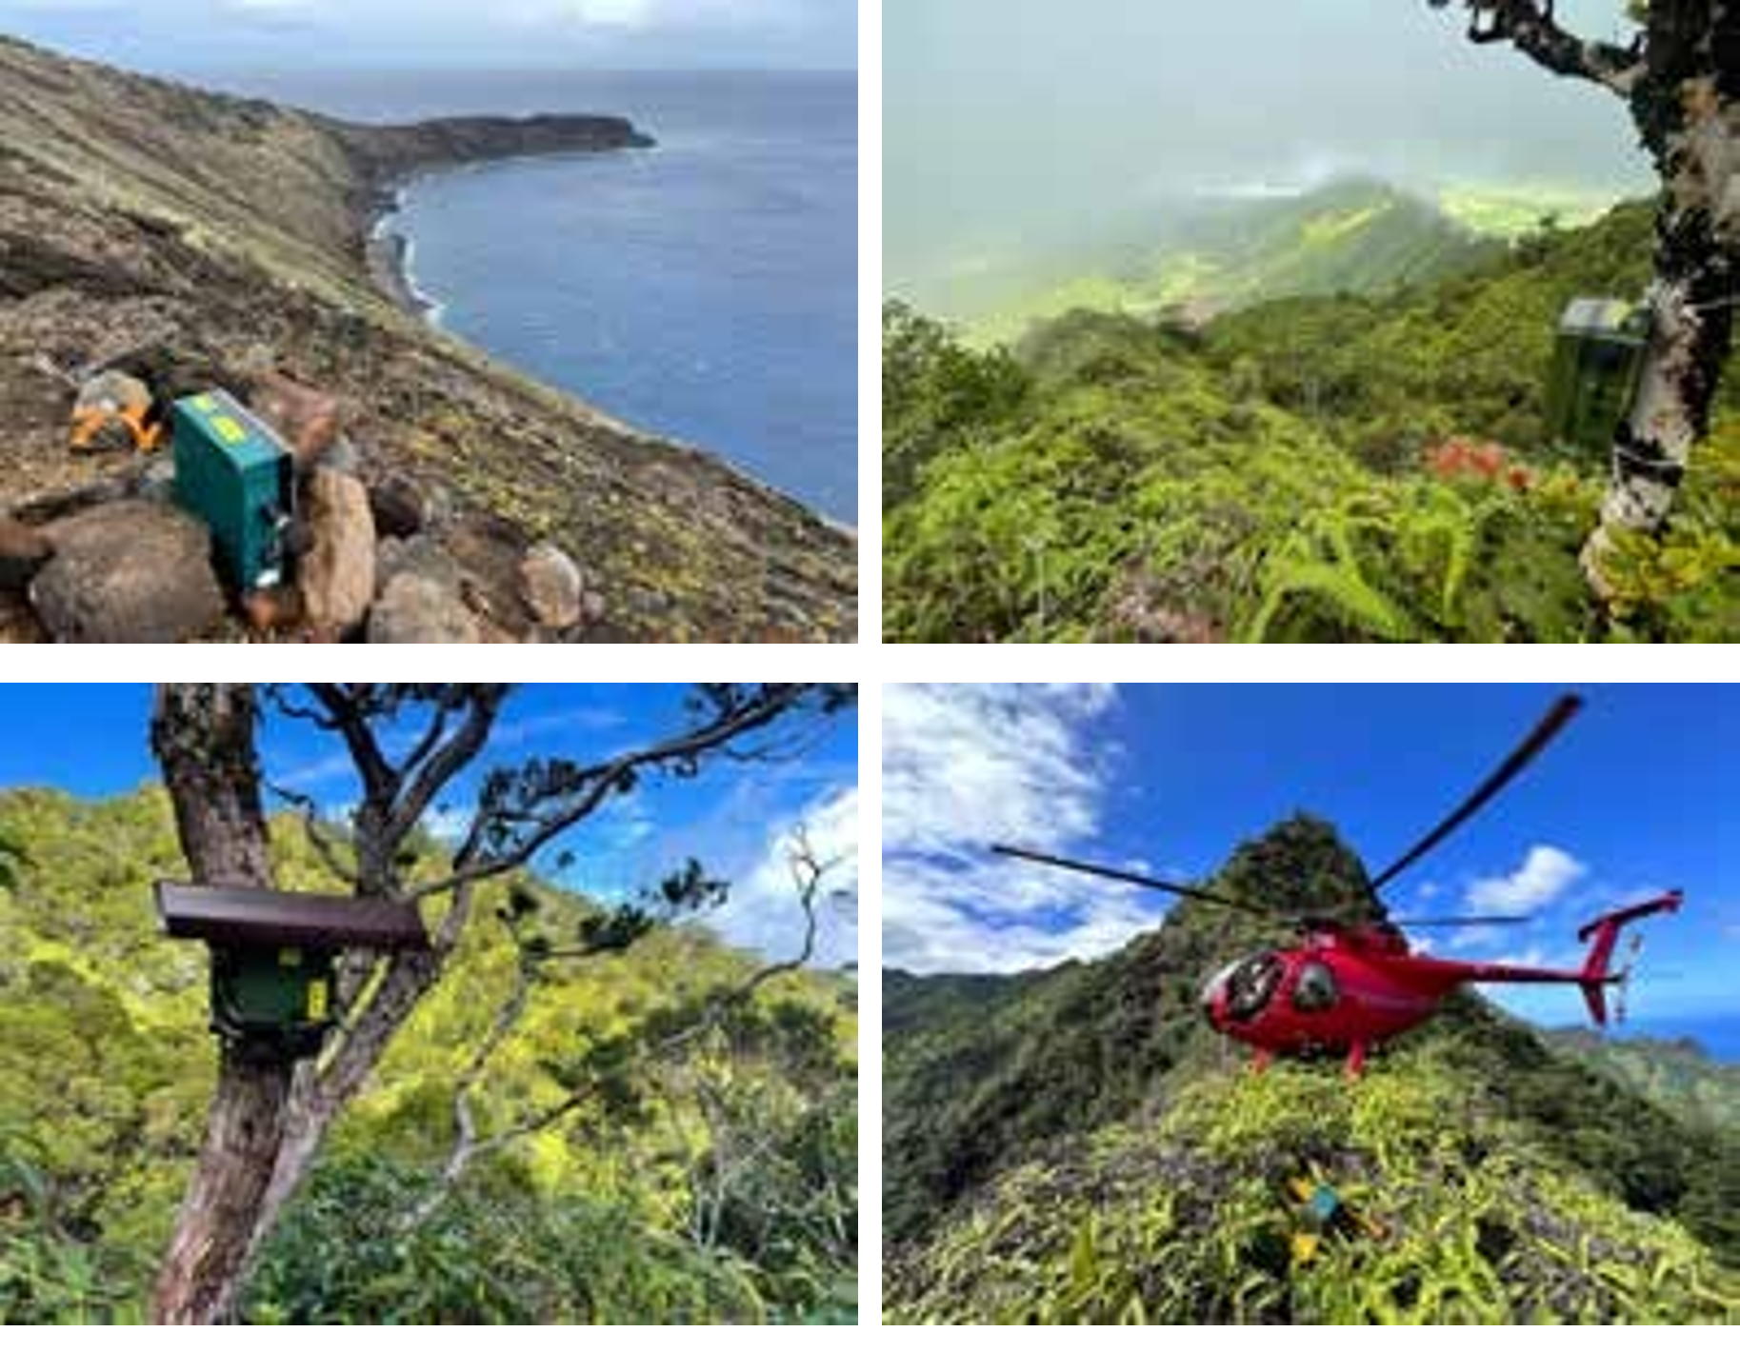
Today’s topics
  Review of the field trip
  Part 2: Survey tools & types
  Part 4: Managing data for conservation
    Updating the Pacific Seabird Colony Database
  Part 5: Resources
  Evaluations
  Closing
Notes:
In today’s workshop we will review what we learned during the field trip yesterday and cover some other surveying tools that could be useful from Part 2 of the Manual.
We’ll also take a deeper dive into managing data, including how to update the Pacific Seabird Colony Database and see if we can record the data we captured during the field visit.
A major part of this is how what we collected feeds into what you already collect for the State of Palau’s Birds report.
Finally, we’ll briefly cover some of the resources in Part 5 of the Manual before evaluations and closing of the workshop.
I’ll hand over to Ray now.
Slide 3: PSSMM Figure 34

Slide 4
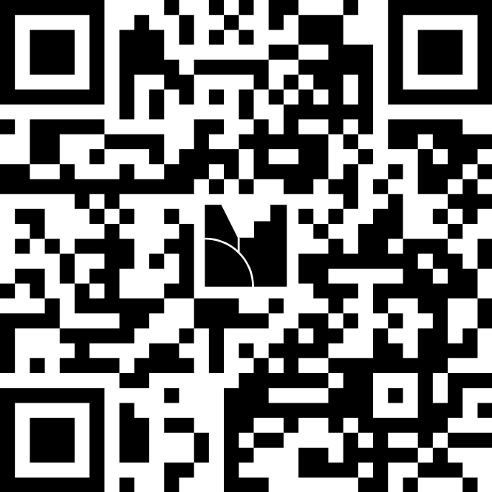
Mentimeter
Mentimeter is a way for people to share their views anonymously
We won’t know what your answers are, we only see the group results
We use Mentimeter to do some spot quizzes throughout the workshop
Let’s try it out…
Use your phone to scan this QR code
Notes:
Mentimeter is a way for people to share their views anonymously
We won’t know what your answers are, we only see the group results
We use Mentimeter to do some spot quizzes throughout the workshop
Let’s try it out…
Use your phone to scan this QR code
If you don’t have a smartphone you can share with other people

Slide 5
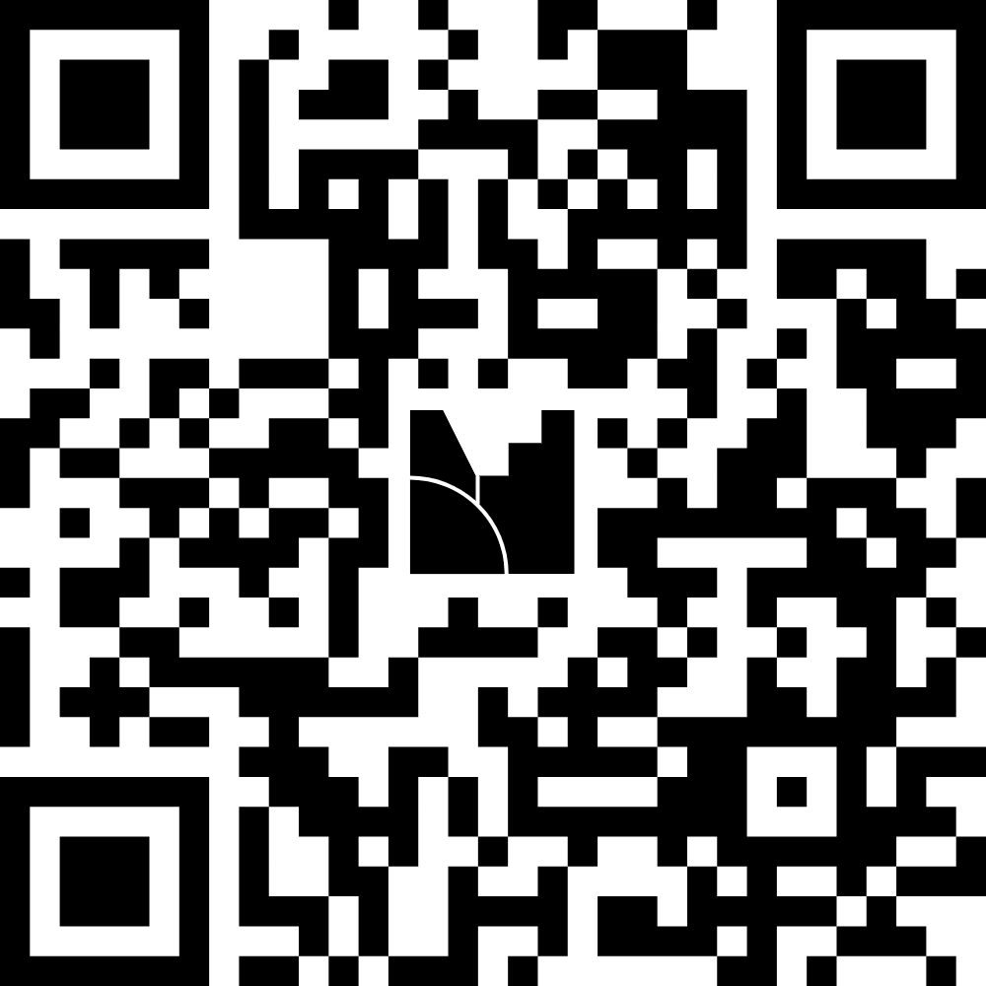
Mentimeter
What did you enjoy most about the field trip yesterday?

Slide 6
Mentimeter - Review of the field trip
Were identification tools useful?
How could the identification tools be better?
Which seabirds were found?
Which seabirds were breeding?
What threats did you see evidence of?
Tools and methods best suited for measuring numbers and ongoing monitoring?
Notes:
In reviewing the field trip, what were the key outcomes and learnings:
- Did identification tools enable easy IDs, or are improvements needed?
What were the seabird species found?
What seabird species were breeding?
What threats were identified and were methods adequate?
What tools and methods were best suited for measuring numbers here and potentially used for ongoing monitoring?

Slide 7
Other surveying methods
Consider other survey approaches including:
  Aerial surveillance (drone)
  Audio
  Remote cameras
  Traps/lures
Notes:
Consider what additional survey approaches would help here including:
Aerial surveillance (drone) – note benefits and limitations – disturbance, damage, malfunction, etc
Audio –note benefits and limitations as above
Remote cameras – note benefits and limitations
Traps/lures – note benefits and limitations

Slide 8
Revise monitoring design for chosen species
Objectives – are these the same?
Methods – any refinements needed?
Data – any changes to data sheet?
Inter-year analyses – any changes?
Notes:
For yesterday’s favored species, do you see any benefits of changing the design following the field trip
Objectives – are these the same as yesterday’s?
Methods – what refinements needed based on reality check?
Data – any changes to data sheet needed?
Inter-year analyses – any changes needed?

Slide 9
Design monitoring for other key species
Species
Objectives
Methods
Data
Inter-year analyses
Notes:
Consider workshopping monitoring design of other key species here as needed.

Slide 10
BREAK

Slide 11
Part 4: Managing data for conservation
4.1 Guidelines for data management
4.2 Pacific Seabird Colony Database
4.3 Working toward better marine conservation
4.4 Seabird restoration projects
Notes:
Part 4 of the Seabirds Manual discusses how to manage data.
You already collect data as part of your bird monitoring, and we have no wish to get you to change that if it is working well already.
But we will cover updating the Pacific Seabird Colony Database.

Slide 12
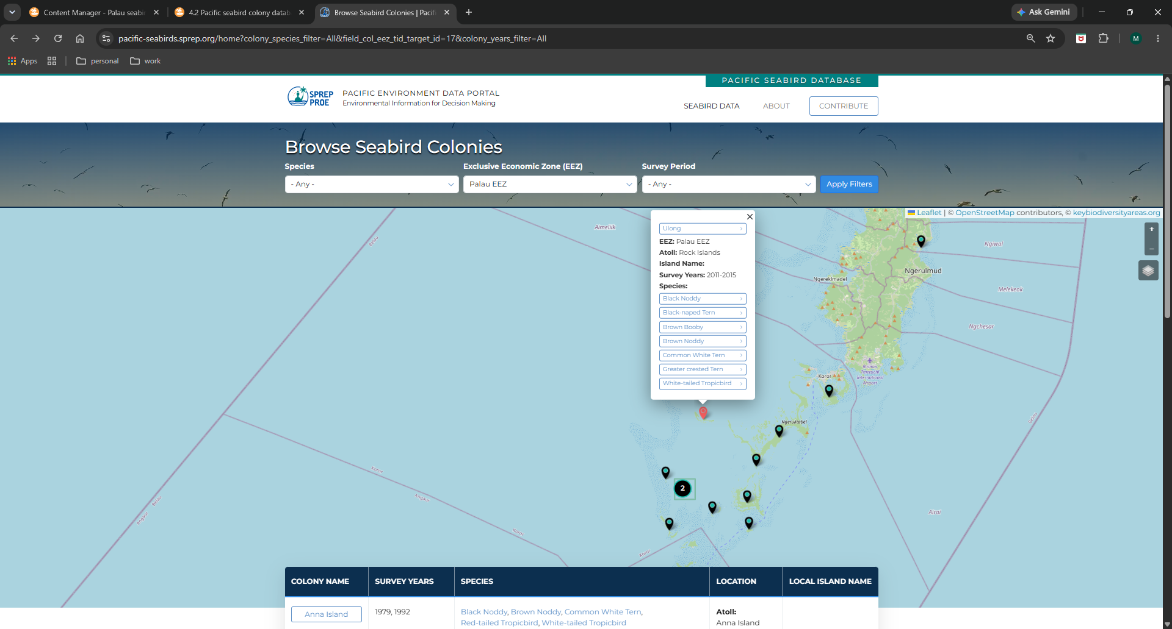
Updating the Pacific Seabird Colony Database
Information on seabird colonies throughout the Pacific: https://pacific-seabirds.sprep.org/
Notes:
You’ll recall we discussed the Pacific Seabird Colony Database on Tuesday, which helps us track population trends and provides access to information about seabirds.
Today we are going to discuss updating it.
[skip to website]

Slide 13
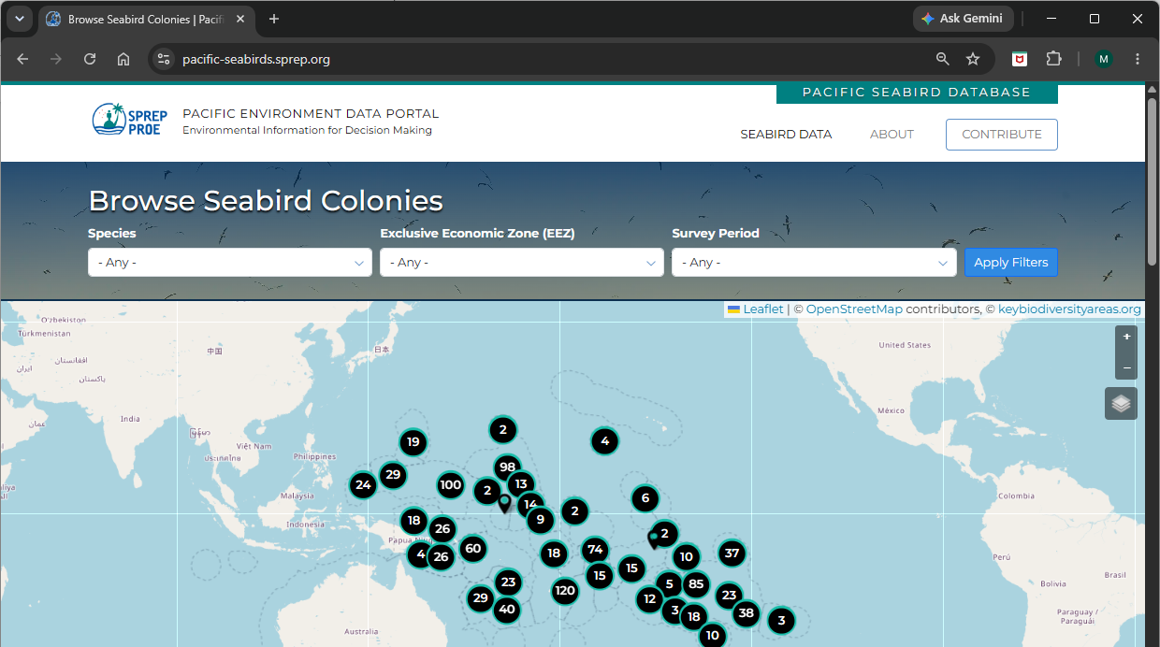
Getting access to update the database
Click on CONTRIBUTE
Notes:
These slides are provided for training-of-trainers reference. During the workshop we will go through these actions directly on the website

Slide 14
Getting access to update the database
Email Lagi Reupena at SPREP lagir@sprep.org to get a username and password
This is a live database so take care adding data
Notes:
These slides are provided for training-of-trainers reference. During the workshop we will go through these actions directly on the website.
That data gets reviewed by Lagi Reupena before it goes “live” but we don’t want to add data that isn’t valid.

Slide 15
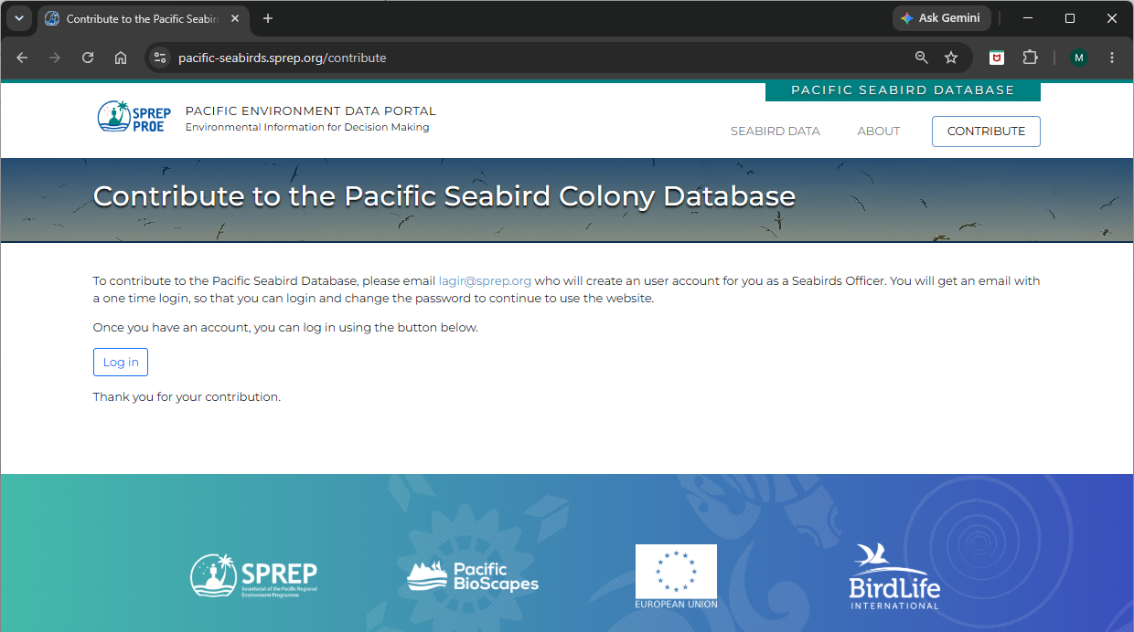
Signing in to update the database
Click on Log in
Notes:
These slides are provided for training-of-trainers reference. During the workshop we will go through these actions directly on the website

Slide 16
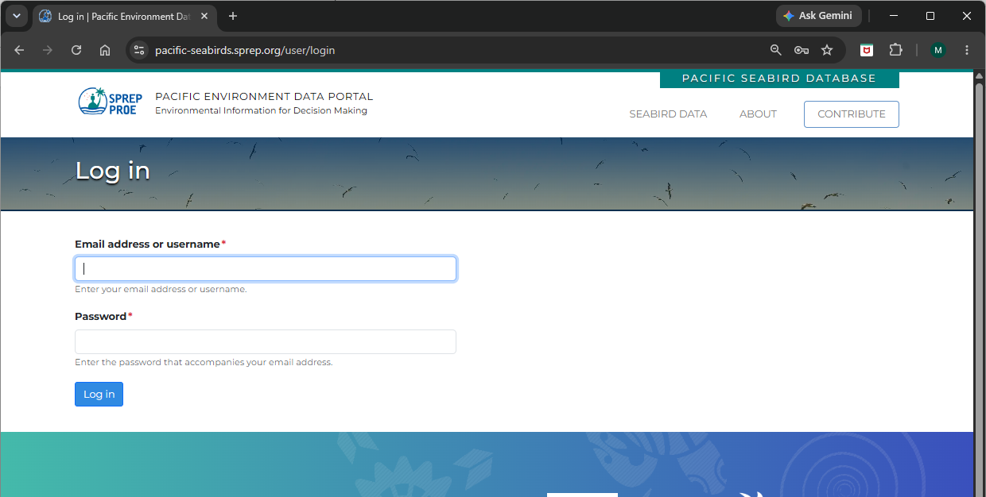
Signing in to update the database
Type in the details you were given by Lagi and click on Log in
Notes:
These slides are provided for training-of-trainers reference. During the workshop we will go through these actions directly on the website

Slide 17
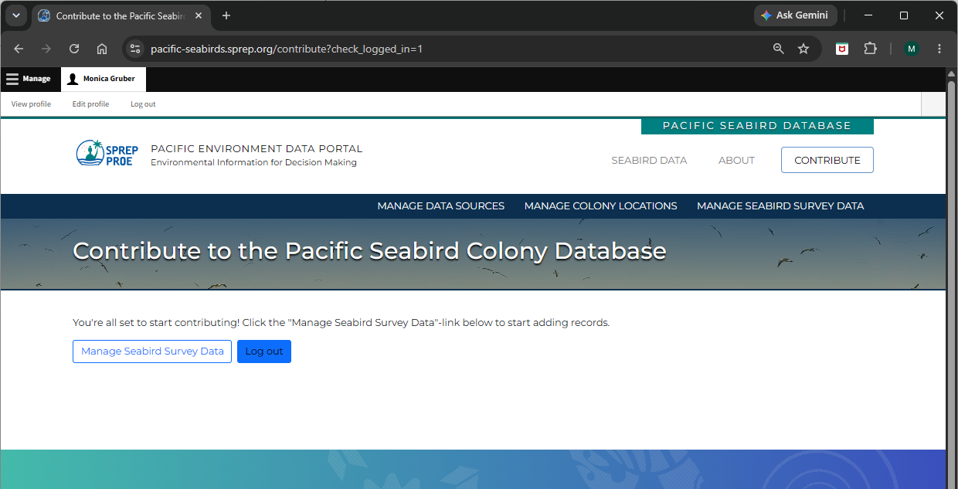
Signing in to update the database
You can see the screen looks different
You can update your details
Notes:
These slides are provided for training-of-trainers reference. During the workshop we will go through these actions directly on the website

Slide 18
Making changes to the database
You can Manage Seabird Survey Data or Log out. Now click on Manage Seabird Survey Data
Notes:
These slides are provided for training-of-trainers reference. During the workshop we will go through these actions directly on the website

Slide 19
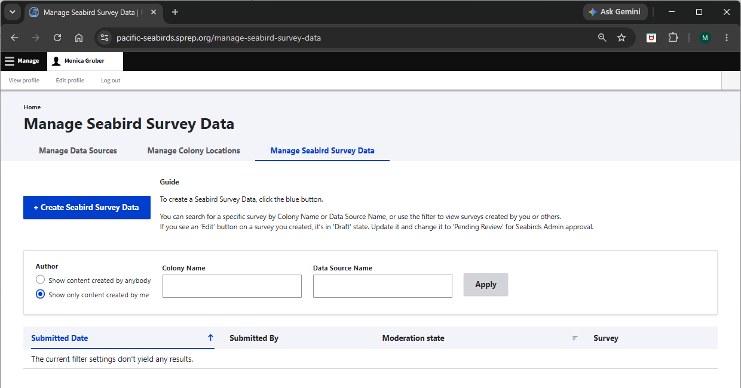
Choosing data to manage
You can Manage Data Sources, Colony Locations and Seabird Survey Data
Notes:
These slides are provided for training-of-trainers reference. During the workshop we will go through these actions directly on the website.
Manage Seabird Data is the default.
Let’s work through the screens starting with Manage Data Sources.
Click on Manage Data Sources.

Slide 20
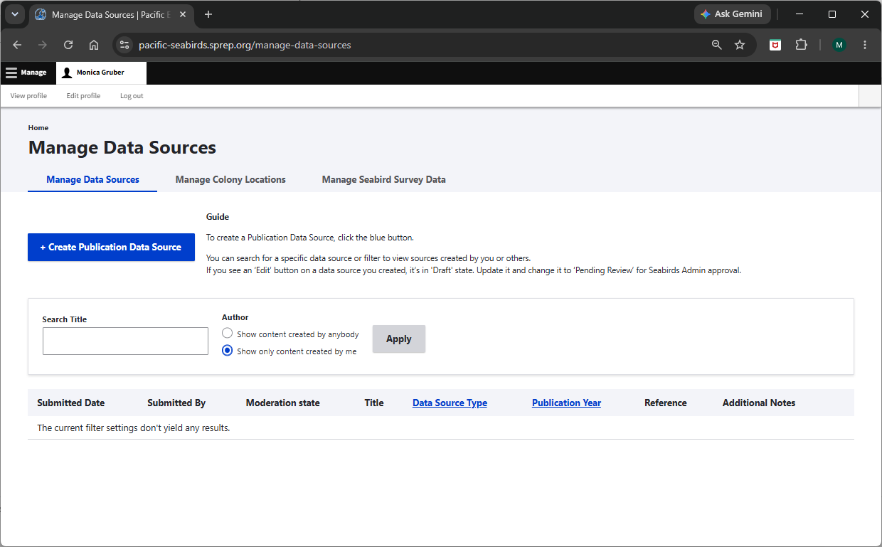
Managing and searching data sources
Click on Manage Data Sources
Notes:
These slides are provided for training-of-trainers reference. During the workshop we will go through these actions directly on the website.
You can add a new data sources, such as a report or look for an existing data source.

Slide 21
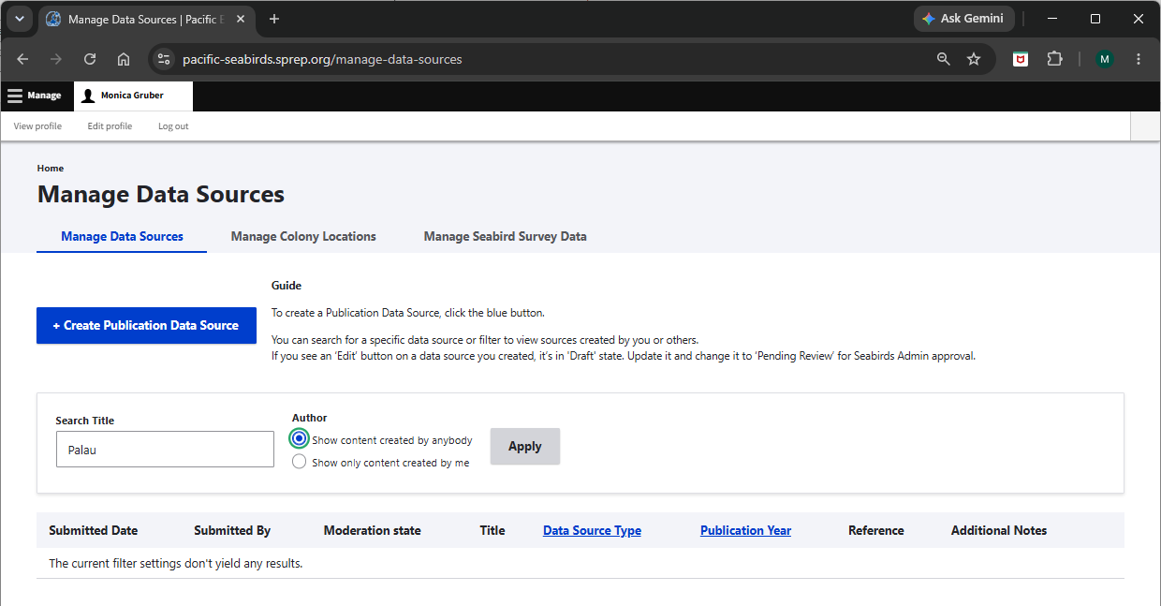
Searching data sources
Add information in the Search Title and change Author. Click on Apply
Notes:
These slides are provided for training-of-trainers reference. During the workshop we will go through these actions directly on the website.
Add information in the Search Title and change Author. Click on Apply.

Slide 22
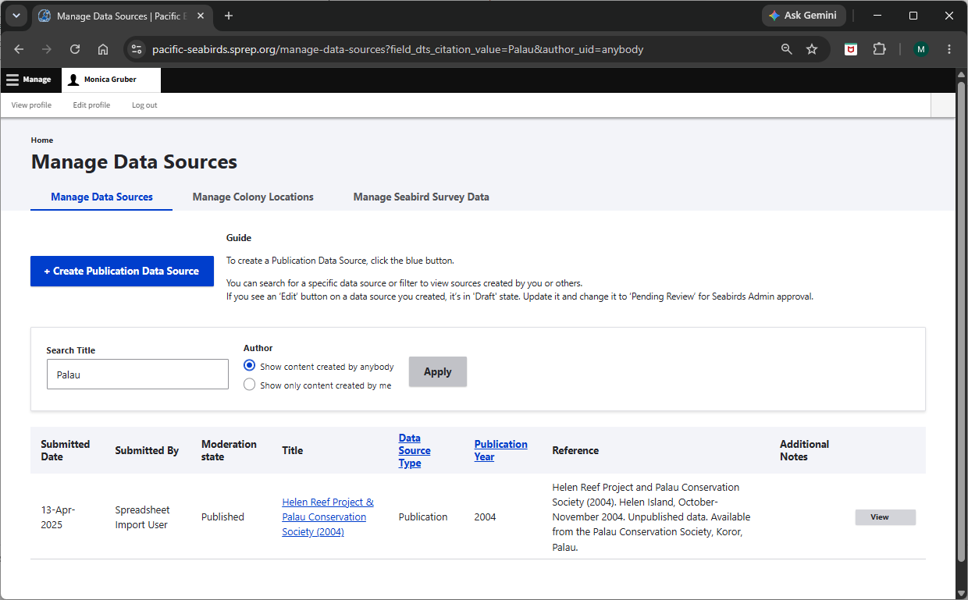
Viewing data sources
All reports with Palau in the title are shown
Notes:
These slides are provided for training-of-trainers reference. During the workshop we will go through these actions directly on the website.
All reports with Palau in the title are shown.
We can see that there is information on a study for Helen Reef that was undertaken in 20024 and that Palau Conservation Society provided the data.

Slide 23
Viewing data sources
Click on View or the Title of the data
Notes:
These slides are provided for training-of-trainers reference. During the workshop we will go through these actions directly on the website.
Click on View or the Title of the data.

Slide 24
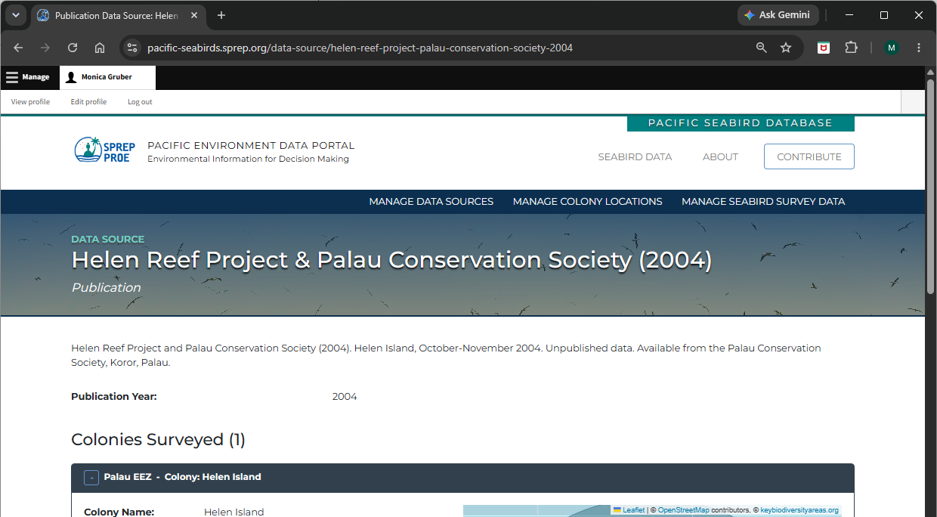
Viewing the data from the survey
We need to scroll down to see more information
Notes:
These slides are provided for training-of-trainers reference. During the workshop we will go through these actions directly on the website.
We need to scroll down to see more information

Slide 25
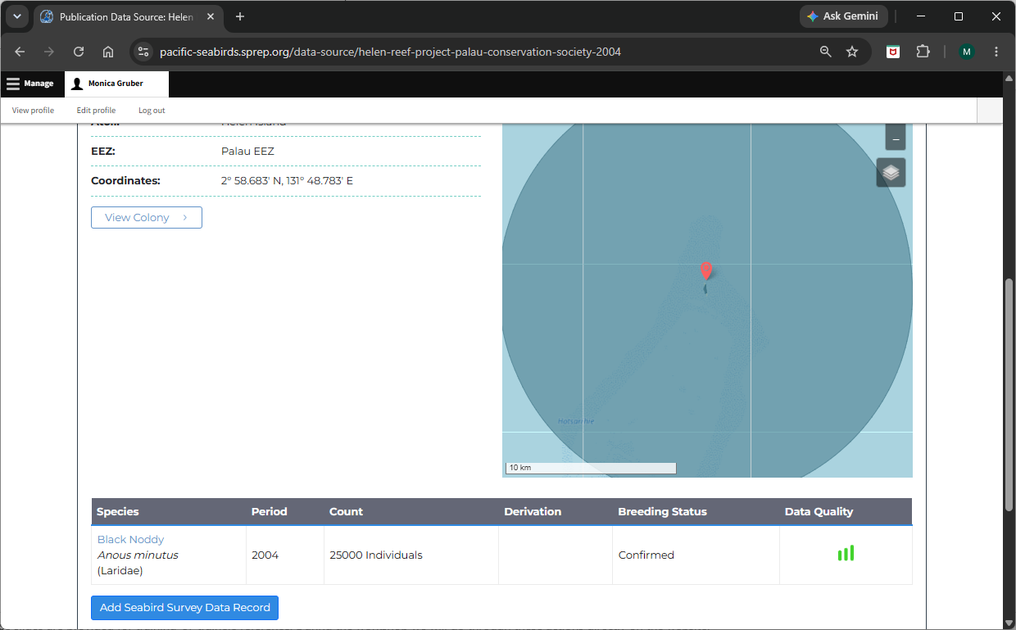
Viewing the data from the survey
Click on View Colony
Notes:
These slides are provided for training-of-trainers reference. During the workshop we will go through these actions directly on the website.
Further down the page is information on the survey, including which species were surveyed.
In this case only Black Noddies were surveyed.

Slide 26
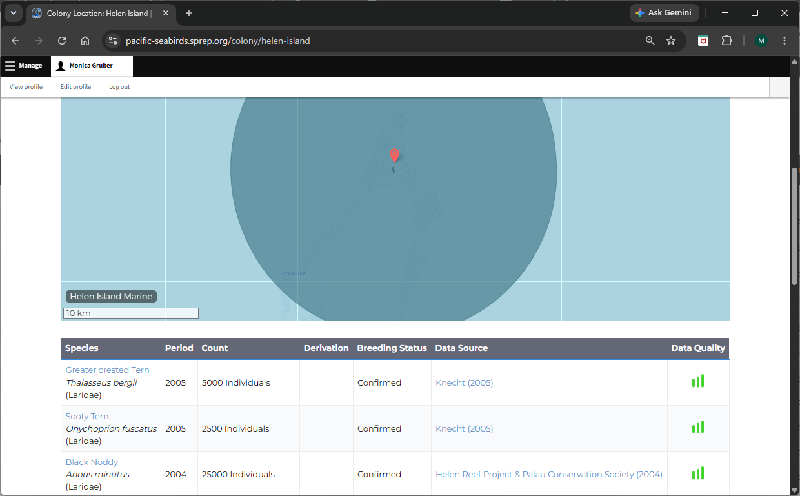
Viewing the data for colony
Click on
Notes:
These slides are provided for training-of-trainers reference. During the workshop we will go through these actions directly on the website.
This brings up all the data for the Helen Reef colony.
Scroll down to see records from different surveys.
We can see the most recent survey was from Knecht in 2005.
We can click on a species name to see information on the database for it.

Slide 27
Viewing the data for colony
Click on a Data Source for more information
Notes:
These slides are provided for training-of-trainers reference. During the workshop we will go through these actions directly on the website.
We can see the most recent survey was from Knecht in 2005.
We can click on that to view details.

Slide 28
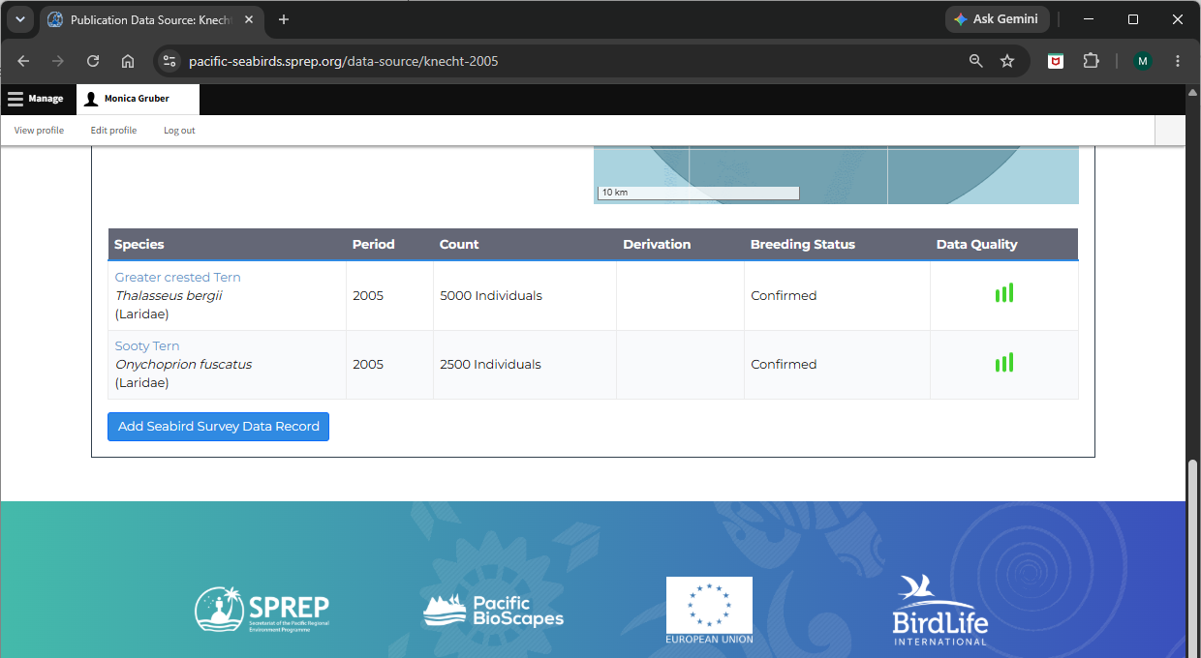
Changing a data source
Click on a Add Seabird Survey Data Record
Notes:
These slides are provided for training-of-trainers reference. During the workshop we will go through these actions directly on the website.
This is the same sort of thing as the original Helen Reef data source we were looking at.
But if we scroll down further we can see there is also the option to Add Seabird Survey Data Record

Slide 29
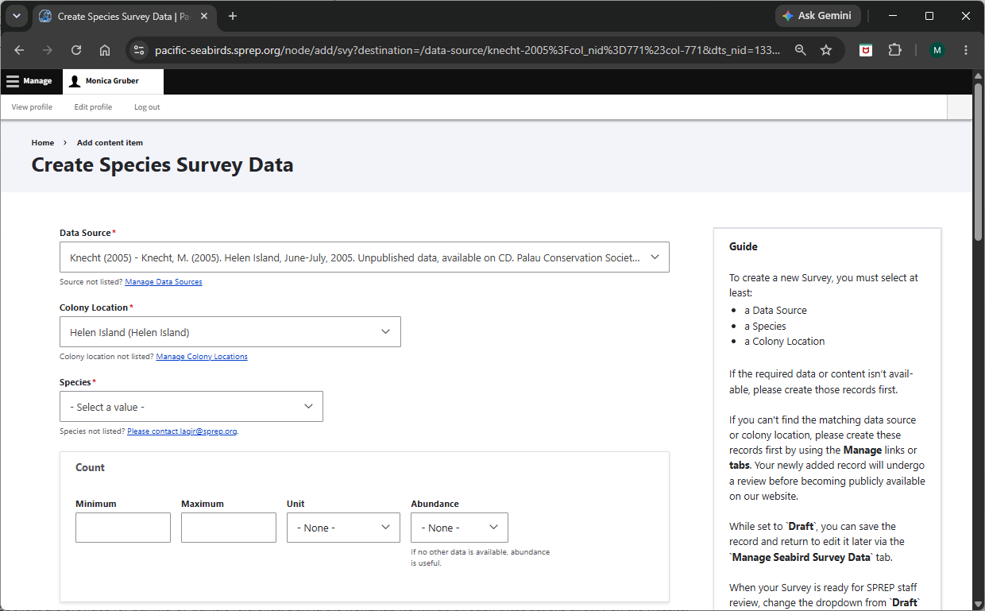
Changing a data source
The Guide provides instructions
Notes:
These slides are provided for training-of-trainers reference. During the workshop we will go through these actions directly on the website.
This brings up a blank record, and you have the option of adding a record to a data source.
The default is the data source we came from, but you can change the Data Source and the Colony Location.
There is a Guide on the right-hand side to assist with adding data.
We don’t want to change any existing data, so we will leave it there.

Slide 30
Summary: Steps for adding data
Add a data source
  Palau seabird workshop 2026
Create Species Survey data
  One record for each observation
You can add observations for earlier surveys, such as State of Palau’s Birds
Data reviewed by Lagi Reupena, who can also bulk add data for you (Spreadsheet Import User)
Notes:
These slides are provided for training-of-trainers reference. During the workshop we will go through these actions directly on the website
Let’s do this for some of the data we collected yesterday.

Slide 31
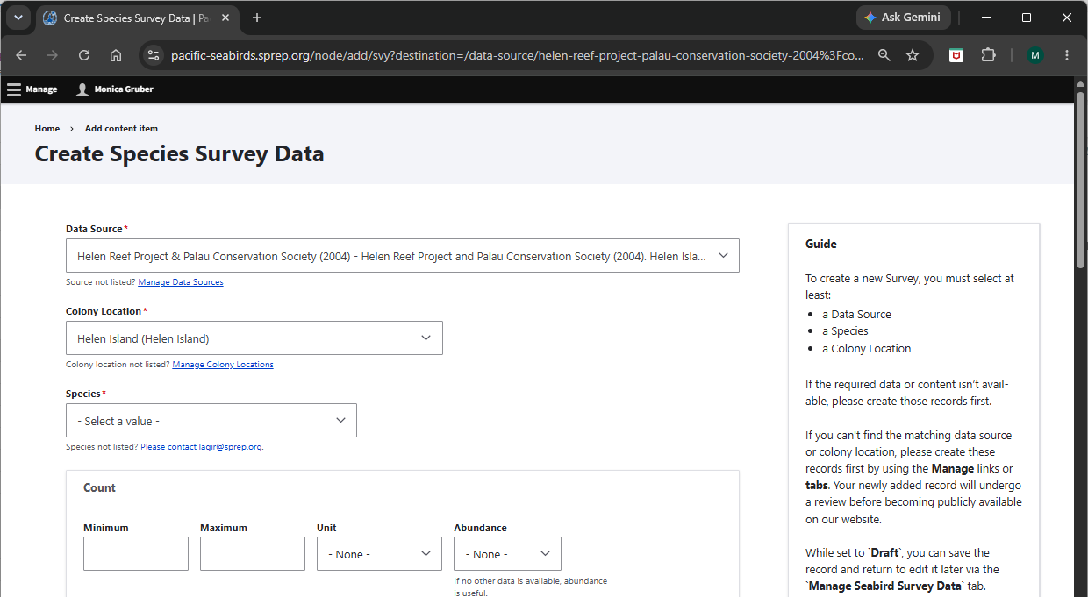
Recording the data captured from the field trip
Click on Home
Notes:
First we’ll go back to the Home screen.

Slide 32
Exercise: Recording the data from the field trip
Notes:
We’ll start with Adding the new data source as a group.
[switch to website].
Then people will add their own records?

Slide 33
LUNCH

Slide 34
Part 5: Resources
5.1 Using this manual
5.2 Pacific seabird advisory group (PSAG)
5.3 Seabird identification keys
5.4 Bird banding schemes
5.5 Important resources
Notes:
Part 5 of the Manual has information about how to use the resources, as well as links to information and resources that could be useful to you.
We will briefly discuss the Pacific seabird advisory group, as its members can provide you with useful advice.
[skip to website]

Slide 35
Part 5: Pacific seabird advisory group (PSAG)
Scope: Focuses on Oceania and the tropical Pacific Ocean
Purpose: Helps coordinate bird banding schemes, standardizes survey methods, and creates basic identification keys for field researchers
Partnerships: Aligns with broader initiatives like the Pacific Seabird Action Plan
Members: Conservation managers, researchers – anyone with an interest in seabirds
Notes:
The Pacific Seabird Advisory Group (PSAG) is a collaborative network to support survey standards, monitoring, and protection of tropical Pacific seabirds.
It works across the whole Pacific region.
The group’s role is to help coordinate bird banding schemes, standardize survey methods, and create basic identification keys for field researchers
It works alongside broader regional efforts by organizations such as the Pacific Seabird Group.
You can contact the PSAG and the Pacific Seabird Group through SPREP if you want expert advice

Slide 36
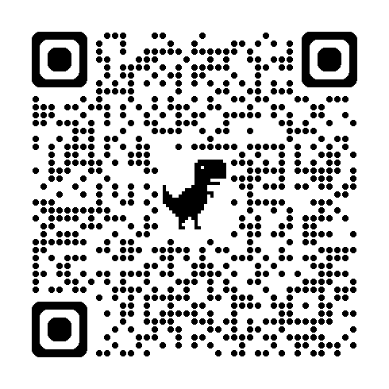
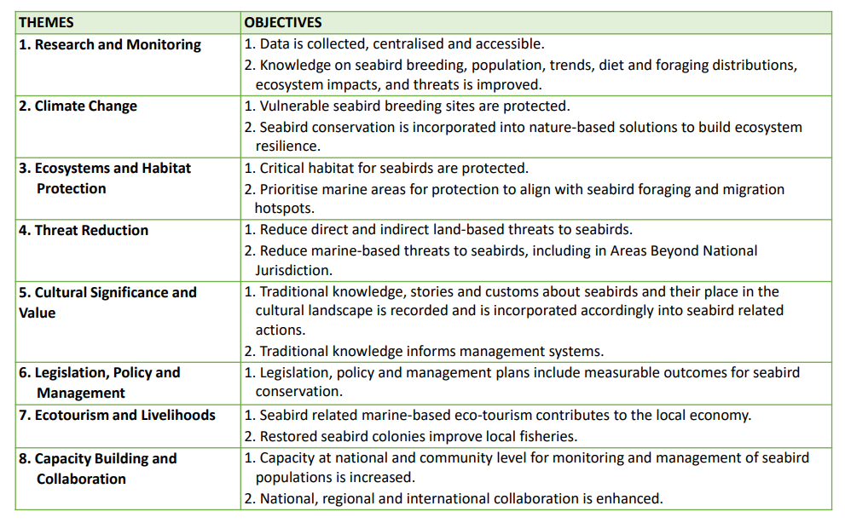
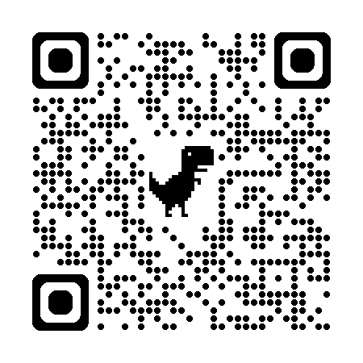
Pacific Seabird Action Plan
Part of Pacific Island Regional Marine Species Programme 2022-2026
Pacific Seabird Action Plan
Pacific Island Regional Marine Species Programme 2022-2026
Notes:
The Pacific Seabird Action Plan outlines the actions that SPREP supports to improve conservation and restoration outcomes for seabirds in the region.
It is part of the Pacific Island Regional Marine Species Programme 2022-2026
It covers sight aspects from Research and monitoring through to capacity building and supporting collaboration.
If you want to learn more about the plan a presentation is available on the SPREP website which you can access through the QR code at the top of this page.
The QR code at the bottom is for the Pacific Island Regional Marine Species Programme 2022-2026
Scan it now if you like

Slide 37
Discussion on planning for monitoring: Suggested questions
What is in our waters? We don't know much on what seabirds are found in Palau. Some bird tracking work shows Black-footed Albatross and Abbott’s Booby in Palau
Where are they? Tropical Shearwater comes in after dusk, but where do they go and where are they most frequently found?
What is happening? Big breeding colonies exist in remote areas, including Greater Crested Terns, Sooty Terns, Noddies, Boobies, and Frigatebirds. There is no monitoring of these colonies to assess population status
Notes:
From Heather

Slide 38
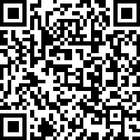
Workshop evaluation
The workshop objectives
Familiarization with
  Seabird biology, ecology and threats
  Seabirds in Palau
Understanding of basic survey methods on-land and at-sea
Practical surveying on-land and at-sea
Managing data related to seabirds in Palau
Scan the QR code with your phone to complete the short evaluation survey
Notes:
Link for people who don’t have a smartphone: https://qualtricsxmtwdmtsxqv.qualtrics.com/jfe/form/SV_cOyegJv22zQTqU6

Slide 39
Tomorrow?
Discussions on seabird monitoring needs for Palau – suggested topics
Benefit to Palau of a national seabird plan
What a national plan would encompass
How well a national seabird plan is likely to be supported among stakeholders
Who would be responsible for the national plan
What type of regional support is available to implement such a plan
How would a national plan fit with existing plans, such as the PAN management plans
Next steps to create the plan (if it is agreed a plan would be useful)

Slide 40
BREAK

Slide 41
Acknowledgements
This workshop was derived from the Pacific Seabirds Survey and Monitoring Manual, which was prepared under contract (AP_2/43) between the Secretariat of the Pacific Regional Environment Programme (SPREP) and the Northern New Zealand Seabird Trust (NNZST)
The Palau workshop resources were developed by Ray Pierce (Eco Oceania) and Monica Gruber (Pacific Biosecurity), based on the resources in Pacific Seabirds Survey and Monitoring Manual, under contract (2026-PBS-001: AP_2/43) between SPREP and Pacific Biosecurity, and deployed on the website: https://seabirds.pacificbiosecurity.co.nz
The project team also acknowledges the contribution of Karen Baird, SPREP's former Threatened and Migratory Species Adviser, who led efforts to develop more seabird resources on behalf of Pacific governments, for the benefit or Pacific communities.
Contributors to the Pacific Seabirds Survey and Monitoring Manual
  Principal authors and editorial team: Chris P. Gaskin (NNZST), André F. Raine (Archipelago Research & Conservation), Kerry A. Lukies (NNZST) and Edin A. Whitehead (NNZST).
  Case study and section contributions by: Alex Wegmann, Katie Franklin, Dana Sabine, Nick Holmes (The Nature Conservancy); Peter Allen, Rohan Clarke, Karina Sorrell (Monash University); Tehani Withers (SOP Manu); Andreas Ravache (Bird Conservation New Caledonia); Nicholas Carlile (Æstrelata Restorations); Richard Griffiths, Paula Castano, Paul Jacques (Island Conservation); Megan Friesen (Wenatchee Valley College); Matt Rayner (Auckland Museum); Sara Thompson, William Sydeman (Farrallon Institute); Kathy Kuletz (U.S. Fish and Wildlife Service); Sophie Laran (La Rochelle Université – CNRS); Stephanie Borrelle and Mark O’Brien (BirdLife Pacific); Steffen Oppel (Swiss Ornithological Institute); Marc Travers (Archipelago Research & Conservation).
  Also, special thanks to Graeme Taylor, Nicholas Carlile, Jay Penniman and Steffen Oppel for reviewing the draft manuscript.
  Participants in the needs assessment review: Bird Conservation New Caledonia; Te Ipukerea Society, Cook Islands; SOP Manu – Polynesian Ornithological Society, French Polynesia; Samoa Conservation Society, Samoa; Vava’u Environmental Protection Association (VEPA), Tonga; American Bird Conservancy (ABC), ABC Marine Programme; Nicholas Carlile; Eric Vidal; Graeme Taylor; Peter Frost; Ray Pierce; Mark O’Brien; Yuna Kim; Jay Penniman; Alex Wang; Brett Mossman; Peter Vaughan; Rohan Clarke; Eric Woehler; Kazuto Kawakami; Kentaro Kazama; Steffen Oppel.
  Numerous photographers have generously contributed images; credits accompany the images.
  Cover images: White-tailed Tropicbird on nest on the island of Kaua’i, Hawaii. Photo: André F. Raine; Sooty Tern colony at Chesterfield Reef, New Caledonia. Photo: Mathieu Mathivet; ‘New Caledonian Storm-petrel’. Photo: Hadoram Shirihai; Research team on Tauturoa, Rapa, French Polynesia. Photo: Tehani Withers.
  Graphic design and layout: Carlo Iacovino.
Notes:
These are the Acknowledgements for the SPREP Seabirds Manual and development of the workshop

Slide 42
Image credits
Most images come from the Pacific Seabirds Survey and Monitoring Manual (PSSMM)
  Cover slide image: Lesser Frigatebirds, Kiribati. Hiroyuki Tanoi
  Slide 3: PSSMM Figure 34

